Slide 1

Project 1
Real Estate
Understanding the Influences upon Property Prices in Melbourne
Presented by:
Kali Notaras, Keerthi Chippa, Basudeb Ghosh, Aayush Gupta, Christopher Banh

Slide 2
Project Description & Outline
For Buyers:
Provide valuable insight into what key attributes contribute to driving property prices.
Consider dependent variables such as land size, building size, number and types of rooms, parking availability, property type, year built and time of sale.
Purchaser demographics.
For Sellers:
Refined pricing estimates
Evaluate the performance of Melbourne’s top real estate agencies.

Slide 3
Facts & Motivation
Fun Facts about Melbourne
Apartments in Melbourne only contribute 7% of the housing stock, making it the most undersupplied city in the western world with regard to apartments and other forms of medium-density housing.
In the last four decades, the Sydney and Melbourne property markets have been among the best and most consistent real estate markets in Australia.
A unit that costs the same as a house of similar size will outperform the house in capital growth.
House prices in some of Melbourne’s more affordable suburbs have soared by at least 47%.
Motivation
Provide an in-depth analysis of property prices in Melbourne with the aim to gain a better understanding of influential variables and inform anyone looking to buy or sell in the market

Slide 4
Datasets & Processes Explained
Dataset: https://www.kaggle.com/datasets/amalab182/property-salesmelbourne-city?select=Property+Sales+of+Melbourne+City.csv
Explaination (accompanied by your Jupyter Notebook):
Data exploration process
Data cleaning process
Data analysis process
Introduction to Data Cleansing

Slide 5
Q1: What are the main influences on Property Prices in Melbourne?
Parameters Used:
Land Size
Building Size
Rooms
Number of Bedrooms
Number of Bathrooms
Parking Spots
Property Type – Unit (u), Townhouse (t), House (h)

Slide 6
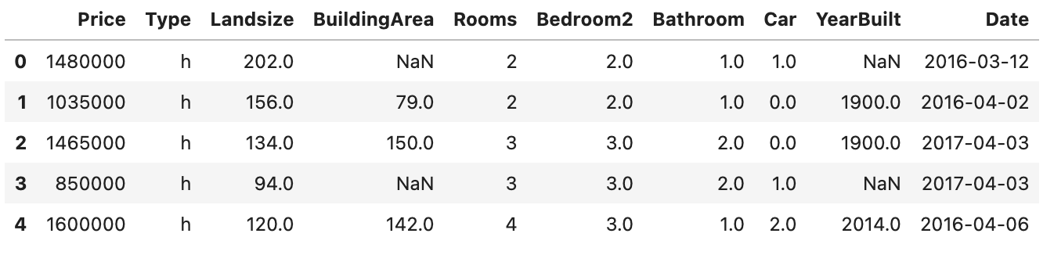
Q1: What are the main influences on Property Prices in Melbourne?
What our data set looks like

Slide 7
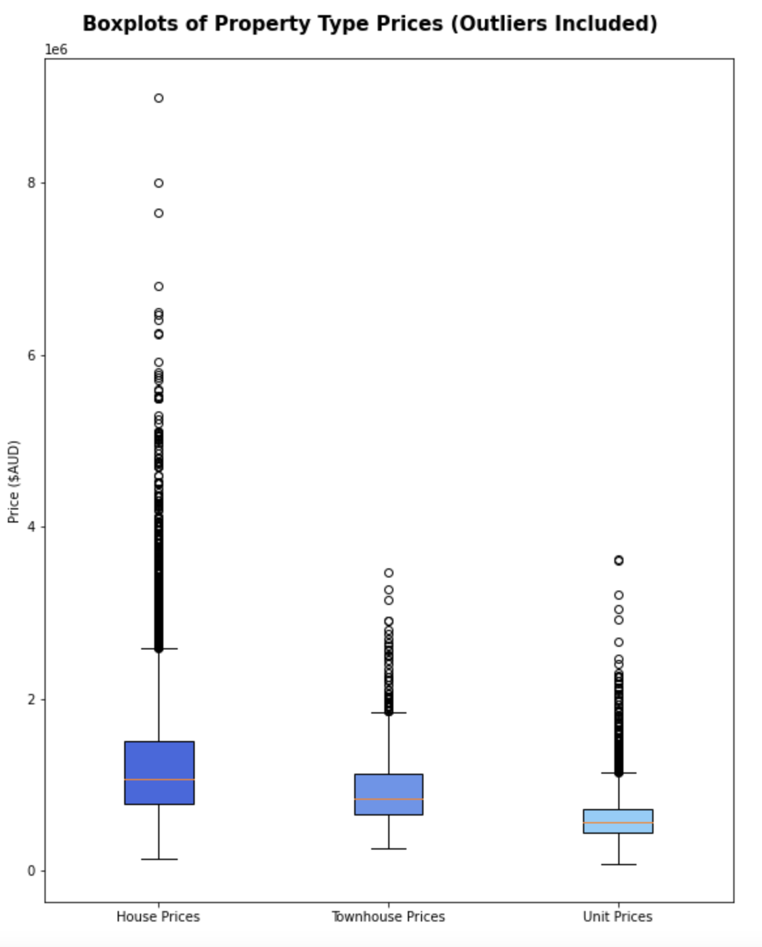
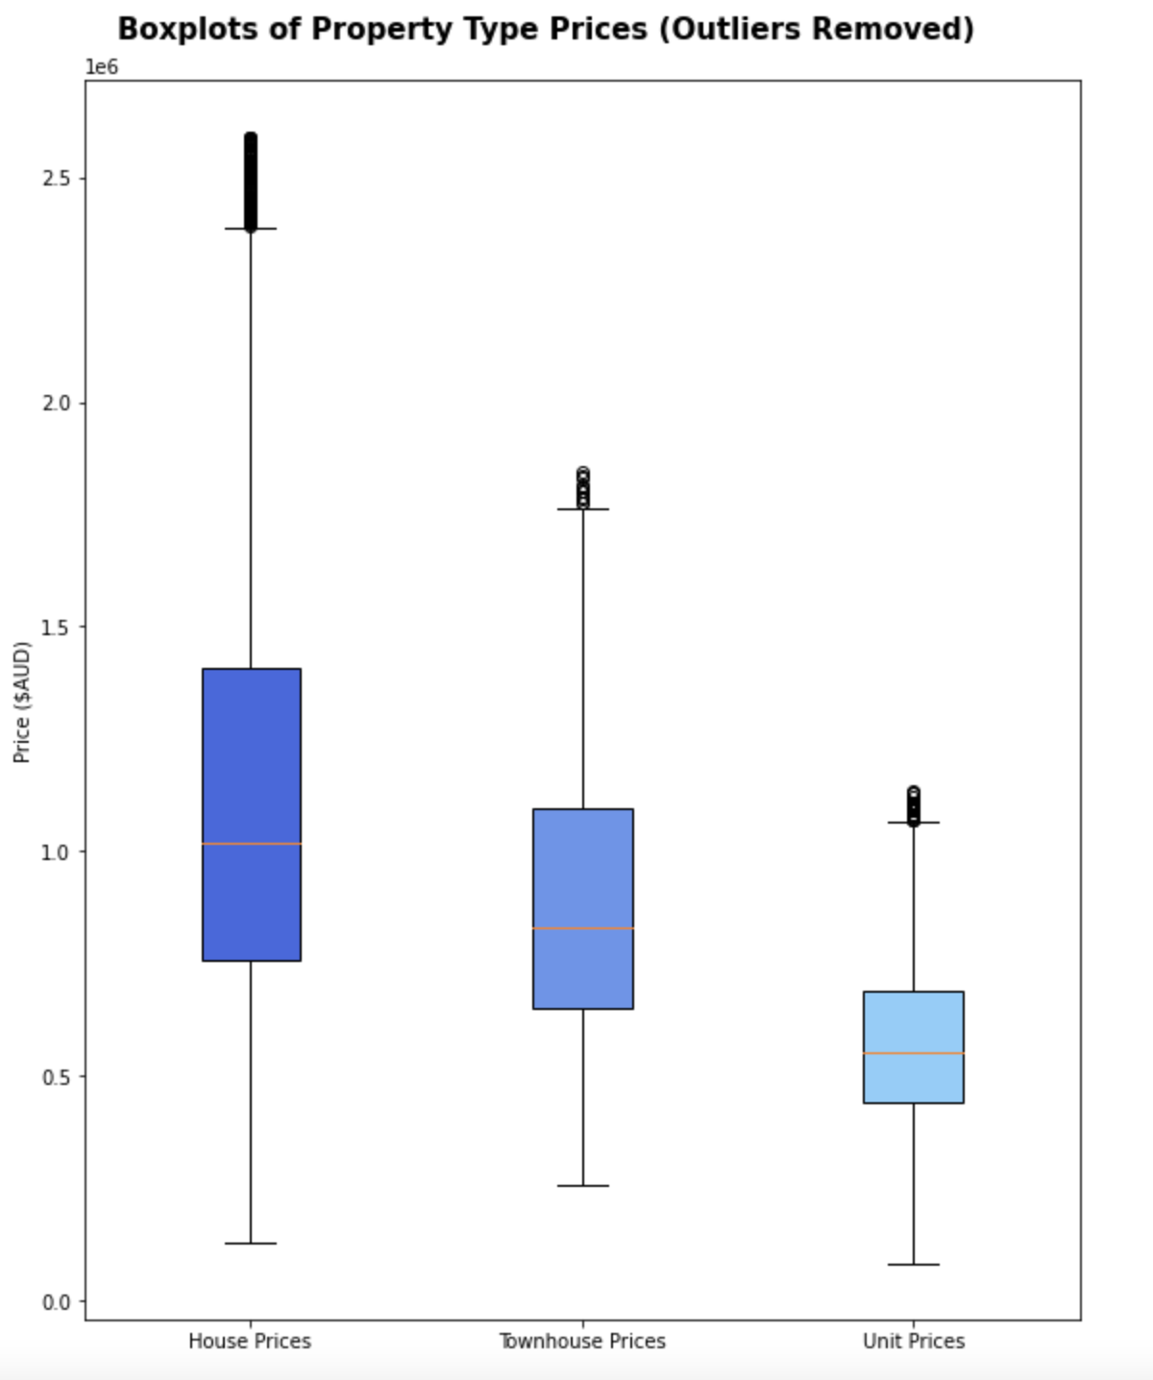
Q1: What are the main influences on Property Prices in Melbourne?
Dataset with and without outliers

Slide 8
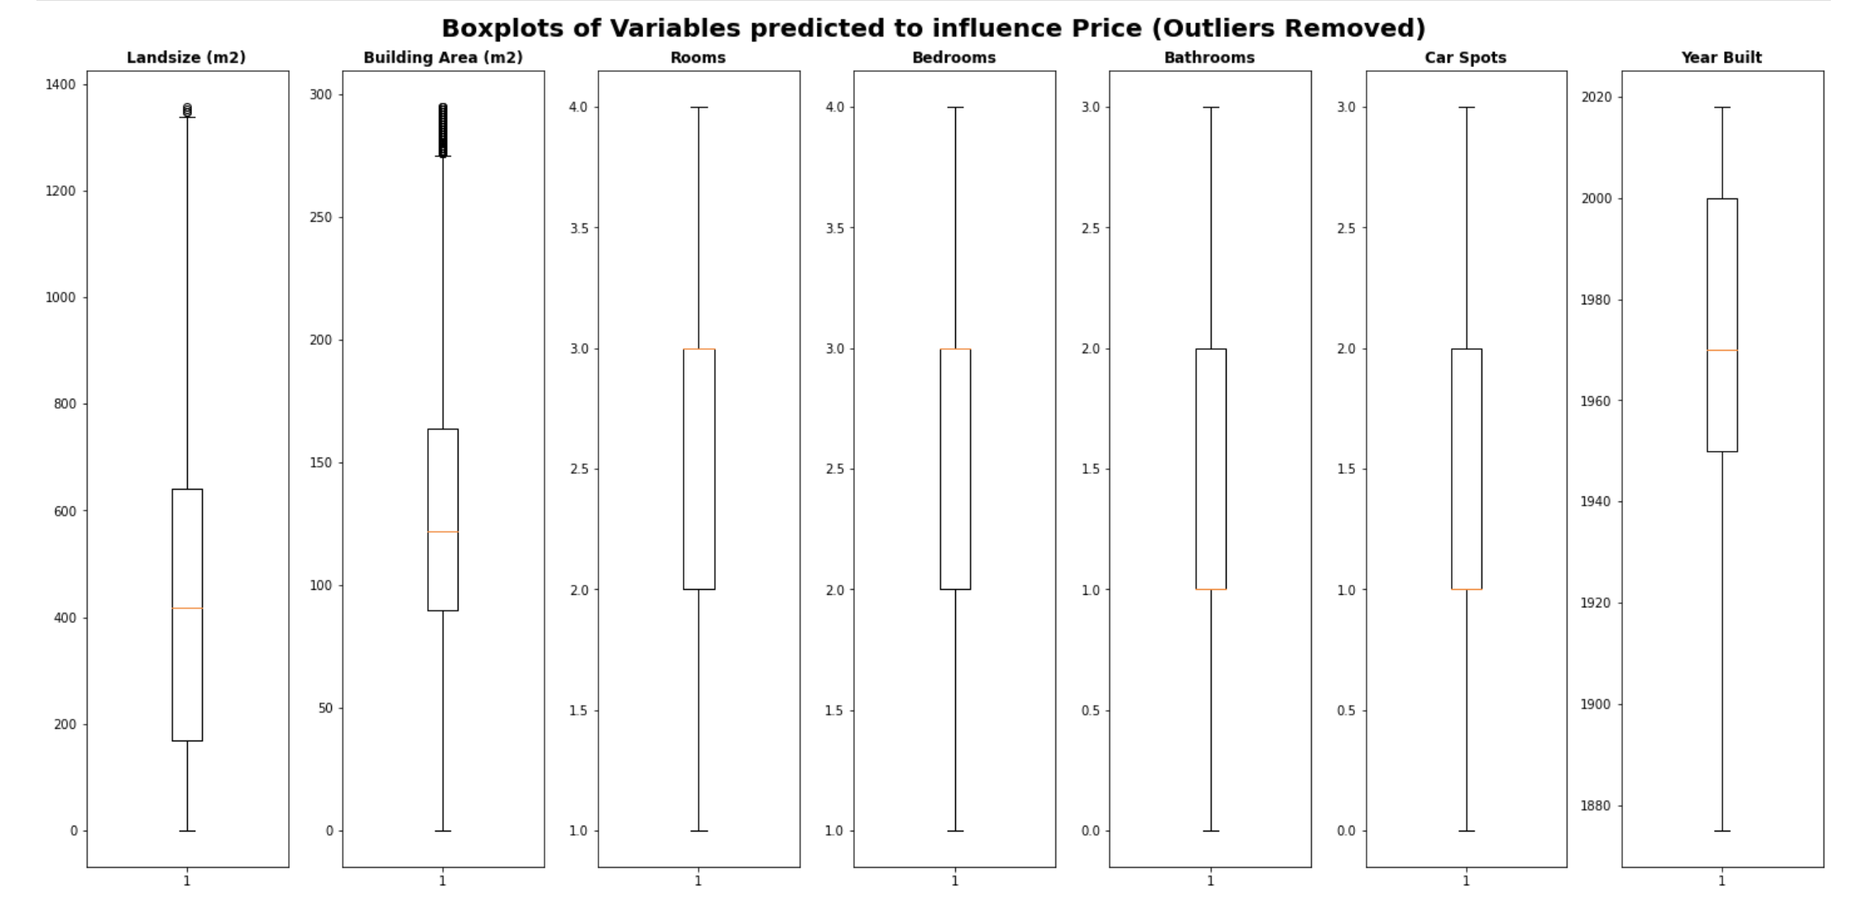
Q1: Variables that have an influence on price (outliers removed)

Slide 9
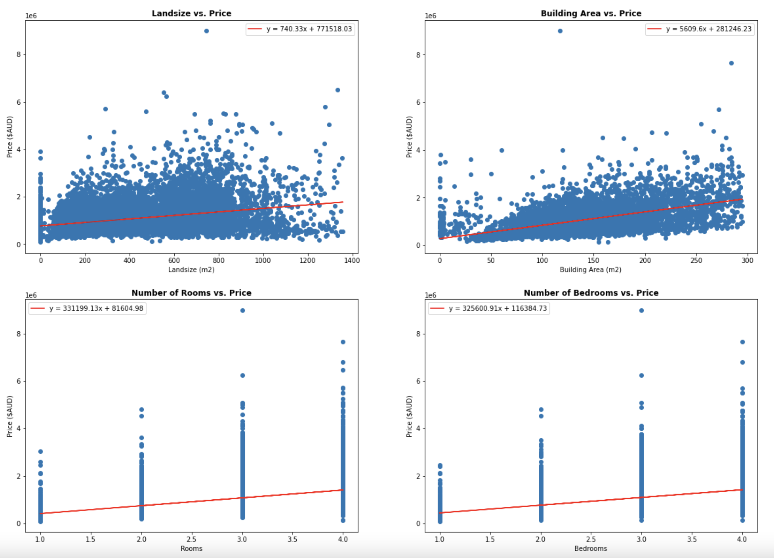
Q1: Scatter plot & linear regression
Land vs Price
Building Area vs Price
Number of Rooms vs Price
Number of Bedrooms vs Price

Slide 10
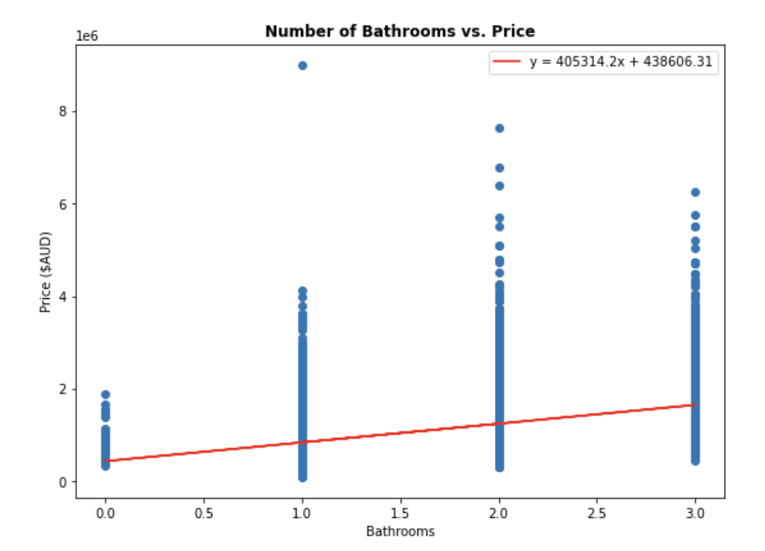
Q1: Scatter plot & linear regression
Number of Bathrooms vs Price

Slide 11
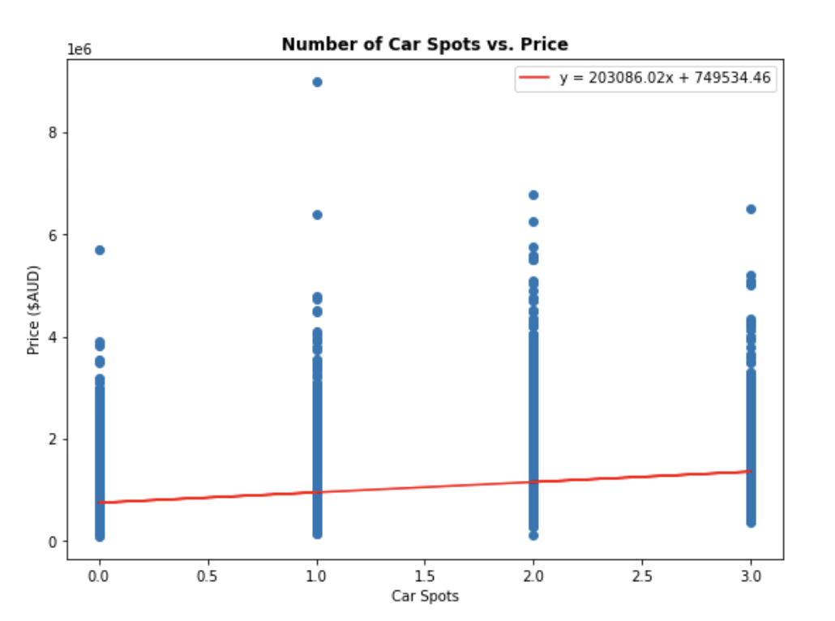
Q1: Scatter plot & linear regression
Number of Car Spots vs Price

Slide 12
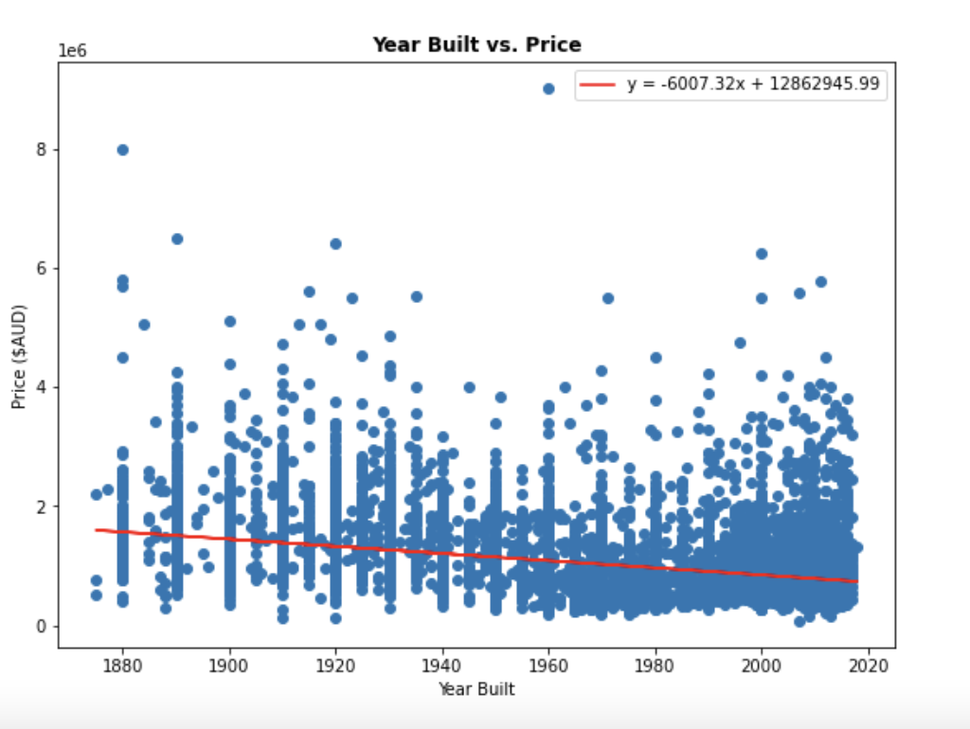
Q1: Scatter plot & linear regression
Year built vs Price

Slide 13
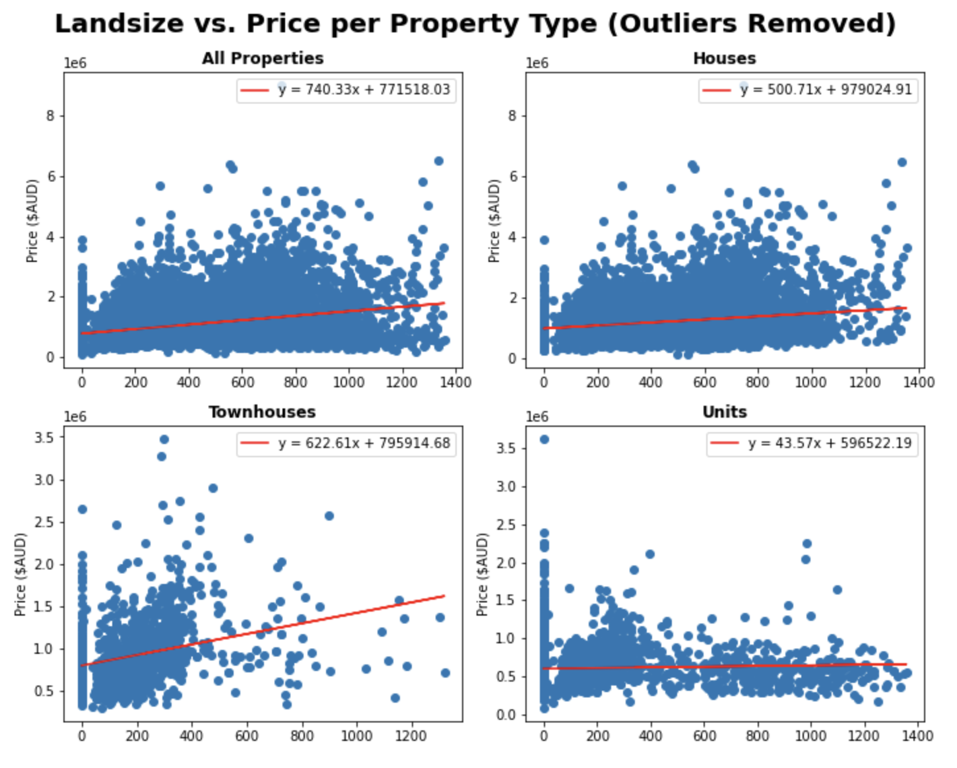
Q1: Landsize vs Price (Outliers Removed)

Slide 14
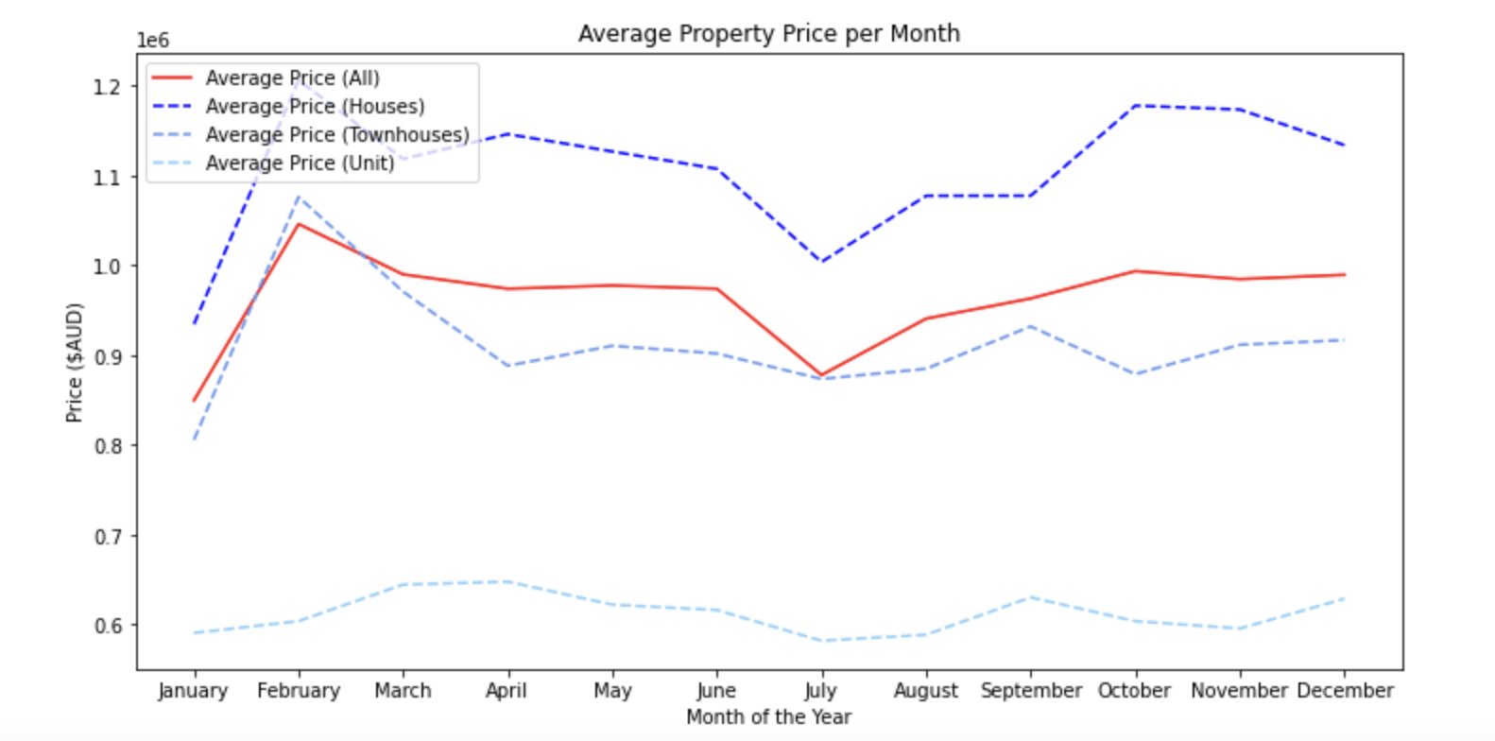
Q1: Line Chart of Average Price per Month

Slide 15
Q2: Looking to buy in Melbourne? What location is best for you and your bank account
Parameters Used:
Distance from CBD
Location
Target Demographic
Property Type – Unit (u), Townhouse (t), House (h)

Slide 16
Q2: Looking to buy in Melbourne? What location is best for you and your bank account

Slide 17
Q3: Looking to sell in Melbourne? Which real estate agency will get you the best value?
Parameters Used:
Number of properties sold
Performance of price above average (Z-score average)
Location-based performance
Method of Sale

Slide 18
Q3: Looking to sell in Melbourne? Which real estate agency will get you the best value?

Slide 19
Final summary of implications
Add some conclusion points

